Slide 1
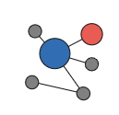
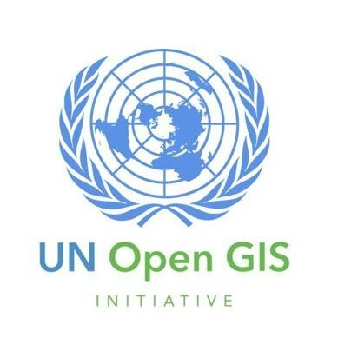


What’s common among these?
Go Data
HDX
Prism
OpenGIS
Notes:
How about we start with a pop quiz. Not something you like to hear in the beginning of a talk at the United Nations.
Give yourself a point if you can point what’s common in these 4 projects.
I will have more questions throughout the talk so please keep track of your points, it’s a honor system.
Bonus point if you can spot is already a DPG
for those high-achievers: What SDG does it align to? (use in slide 14)
GoData data collection tool, developed at the WHO, manages large amounts of data generated during an outbreak & visualizes the transmission of the disease to help responders make the right decisions to halt the spread of disease.
HDX, platform for finding, sharing, & using humanitarian data from datasets around the world.
Prism, developed by the World Food Programme, A climate risk monitoring system that combines geospatial data on hazards (droughts, floods, tropical storms & earthquakes) with information on (socioeconomic) vulnerability in order to (monitor risks, prioritize responses & to) inform disaster risk reduction & social assistance programs.
Finally, OICT’s very own UN Open GIS An effort to promote the use of open-source geospatial technologies across the UN, enhancing collaboration & interoperability between various UN agencies & stakeholders.
What these four projects have in common is that they are all open source initiatives. Next slide
& it's an honor to be speaking to you today about the power of open source software. I am here because I was inspired by the power of collaboration & it's limitless potential.
Add OICT OpenGIS - Omar http://unopengis.org/unopengis/what/what04.php
Humanitarian Data Index
Notes/Feedback: should we add digital public goods - prism or others from the WHO?
https://innovation.wfp.org/project/prism
Here is a project with the World Food Programme:
PRISM https://github.com/WFP-VAM/prism-app
Here's the list of https://digitalpublicgoods.net/registry/ which are open source projects specifically for public goods
PRISM is a climate risk monitoring system developed by the World Food Programme (WFP) that integrates geospatial data on hazards such as droughts, floods, tropical storms, and earthquakes, with information on socioeconomic vulnerability. The goal is to inform disaster risk reduction and social assistance programs. The platform provides tools to governments, national disaster management organizations, and key line ministries to monitor risks, prioritize responses and inform programs and policies. PRISM produces interactive maps, charts, tables and reports that display climate risk monitoring indicators and risk and impact analytical products. The information can be used to mitigate the impact of climate-driven hazards by providing decision-makers with the most up-to-date risk and impact analytics. PRISM is actively used by government partners in Indonesia, Sri Lanka, Mongolia, and Cambodia and is forthcoming in several deployments across Asia and Africa. The project is recognized as a digital public good by the Digital Public Goods Alliance.
SDG1: End Poverty in all its forms everywhere,
SDG2: Zero Hunger,
SDG11: Sustainable Cities and Communities,
SDG13: Climate Action
Go.Data is a data collection tool developed by WHO and GOARN Partners to manage large amounts of data generated during an outbreak. It is designed for outbreak investigators and epidemiologists and allows for rapid data entry and better visualization of chains of transmission. The tool runs in both standalone and connected modes, offers access through mobile devices, and will be made available globally to WHO staff, Member States, and Partners.

Slide 2
Open Source Software - Vision, Benefits, Challenges
Presented by GitHub and UNOICT
Notes:
& it's an honor to be speaking to you today about the power of open source software. Next slide
I am here because I was inspired by the power of collaboration & it's limitless potential.

Slide 3

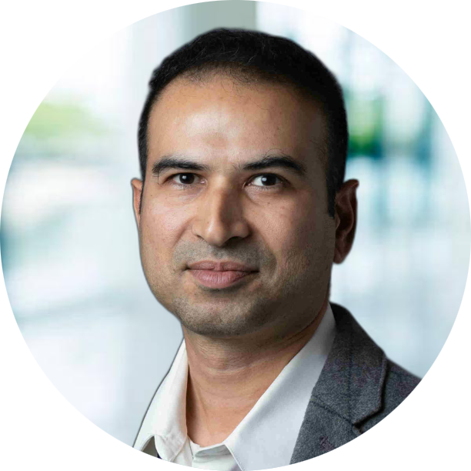
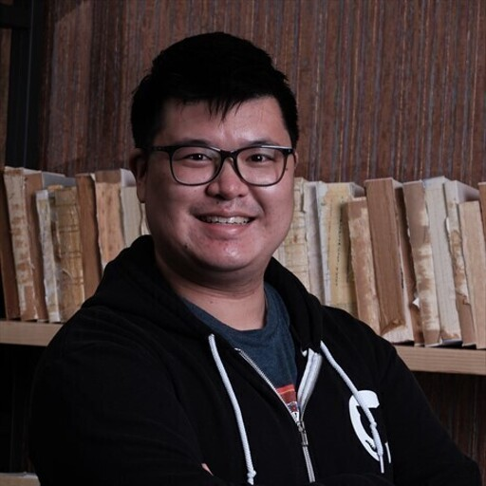

Introduction - GitHub Team
Belinda Vennam
SKi Sankhe
Joshua Ku
Cynthia Lo
Senior Manager, Software Engineering
Senior Solutions Architect
Service Delivery Engineer
Program Manager
Notes:
This is my wonderful team who is going to help with the WHAT and the HOW to open source in the following sessions so stick around or catch the recordings if it's too late where you are.
I am going to be start with the WHY (shout out to any simon sinek fans out here).

Slide 4

What’s common among these projects?
Go Data
Linux
PRISM
Notes:
Add OICT OpenGIS - Omar http://unopengis.org/unopengis/what/what04.php
Humanitarian Data Index
https://www.top500.org/statistics/list/ https://w3techs.com/technologies/overview/web_server Notes/Feedback: should we add digital public goods - prism or others from the WHO?
https://innovation.wfp.org/project/prism
Here is a project with the World Food Programme:
PRISM https://github.com/WFP-VAM/prism-app
Here's the list of https://digitalpublicgoods.net/registry/ which are open source projects specifically for public goods
PRISM is a climate risk monitoring system developed by the World Food Programme (WFP) that integrates geospatial data on hazards such as droughts, floods, tropical storms, and earthquakes, with information on socioeconomic vulnerability. The goal is to inform disaster risk reduction and social assistance programs. The platform provides tools to governments, national disaster management organizations, and key line ministries to monitor risks, prioritize responses and inform programs and policies. PRISM produces interactive maps, charts, tables and reports that display climate risk monitoring indicators and risk and impact analytical products. The information can be used to mitigate the impact of climate-driven hazards by providing decision-makers with the most up-to-date risk and impact analytics. PRISM is actively used by government partners in Indonesia, Sri Lanka, Mongolia, and Cambodia and is forthcoming in several deployments across Asia and Africa. The project is recognized as a digital public good by the Digital Public Goods Alliance.
Go.Data is a data collection tool developed by WHO and GOARN Partners to manage large amounts of data generated during an outbreak. It is designed for outbreak investigators and epidemiologists and allows for rapid data entry and better visualization of chains of transmission. The tool runs in both standalone and connected modes, offers access through mobile devices, and will be made available globally to WHO staff, Member States, and Partners.

Slide 5
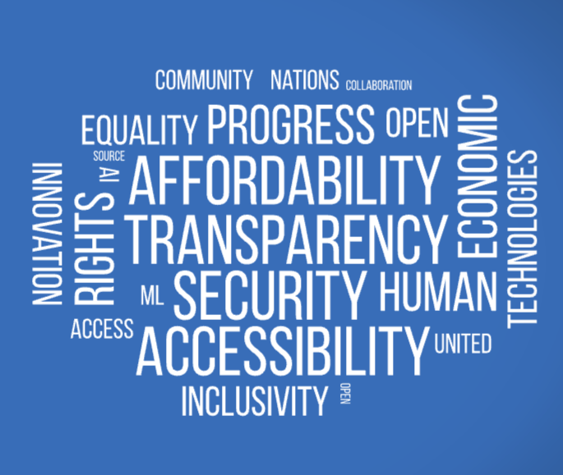
Benefits
Notes:
Now Let’s look at the benefits.
Most of you are thinking, yes I know this already & am interested in the WHAT & the HOW;
I am going to re-iterate, for the benefit of those 1%, who are still unsure about using open source &
I found the perfect way to answer it.
This is also going to be the method that most of you will do if not already.

Slide 6
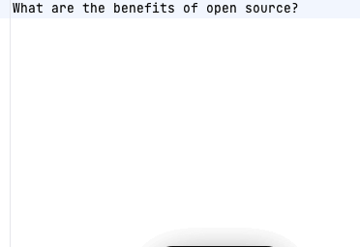
I asked an AI about benefits
Notes:
I would be remiss if I didn't add a slide created purely by AI. So I asked AI about the benefits, & it promptly spit out a long list until I had to stop it because it just kept on going.
To paraphrase,
It’s free , collaborative, constantly evolving & secure, making it an attractive alternative for many developers & users.
It’s open for anyone to contribute, so it's great for developers with the knowledge & passion to make a difference.
Considering the goofy responses you may have seen posted on social media, this is pretty spot on for an AI. LLMs are trained on huge corpus of data, & have the potential, to represent collective thought, in most cases incorporating the biases of the training data, which is yet another reason why we need open source AI models. I do have some good news to share and going to save it for later.
What kind of data does the LLM have to ingest to output this kind of a response? One would start with data available in the public domain and maybe if you want some personalization /vertical specialization you could potentially use data that only available to you.
What data (public vs private vs users) gets fed into the model would be determined by the organization training the model.
Data could originate from studies done on open source cost benefit analysis such as a landmark study in 2021 was published by the European Commission.

Slide 7

It is possible to identify and to quantify a significant economic impact of the commits or contributors to GitHub from the EU Member States on the GDP in the EU. The impact ranges from €60 billion to €95 billion to the GDP in the EU in 2018.
https://digital-strategy.ec.europa.eu/en/library/study-about-impact-open-source-software-and-hardware-technological-independence-competitiveness-and
Notes:
They found open source contributed between €65 & €95 billion to the European economy in 2018. This is a clear indication of the value of open source, & a testament to the global impact of open source collaboration.
And that’s the reason over the past years, AI & open source continues to attract unprecedented attention from governments, & the global policy community. But what's most exciting to me is the growing recognition of the need for public policy to foster, or at least not harm, open source development.
•Open source software and hardware has a significant economic impact on the GDP in the EU, ranging from €60 billion to €95 billion in 2018.
•Open source learning process makes people adaptable and gives them a benefit over others in the job market.
The role of open source software is mentioned in principle 9 of the declaration
1, which states that digital technologies should be based on open standards and interoperability, and that public authorities should make more use of open source solutions
2. Open source software is also seen as a driver of EU’s digital innovation and competitiveness, as well as a way to increase transparency and avoid vendor lock-ins34.
The European Declaration on Digital Rights and Principles for the Digital Decade is a joint statement by the EU institutions that sets out the vision for a digitally transformed Europe by 2030. It affirms that digital technologies should protect and promote human dignity, democracy, equality, rule of law and fundamental rights. It also outlines principles that guide the EU’s digital policies and actions, such as access to digital services, data protection, digital education, innovation and sustainability. The declaration aims to foster a common understanding and commitment among all stakeholders to shape a human-centred digital transition.
threats EU & UN are cyberattacks, disinformation, climate change, terrorism, and geopolitical instability One way that open source software model can help mitigate these threats is by promoting digital sovereignty
2, which means having control over one’s own data and digital infrastructure. Open source software model can also foster digital public goods
3, which are open-source solutions that adhere to privacy and other applicable laws and best practices, do no harm, and help attain the SDGs.
https://ec.europa.eu/newsroom/dae/redirection/document/79021
https://digital-strategy.ec.europa.eu/en/library/study-about-impact-open-source-software-and-hardware-technological-independence-competitiveness-and
Approach-31
Open Source Software in the context of other concepts31
Economics of OSS 35
Framework conditions for OSS -36
Impacts of OSS -42
Literature on Open Source Hardware -45
OVERVIEW OF METHODOLOGICAL APPROACH - 47
Case studies, business models and taxonomies --47
Economic impact analysis: macro and micro level--48
Stakeholder survey--49
Final analysis -50
Public policy analysis --50
Policy recommendations-52
CASE STUDY ANALYSIS, BUSINESS MODELS AND TAXONOMIES -- 54
Introduction --54
Case study methodology 54
Dimensions of openness and hardwareness of software and hardware 55
Business models and value propositions 58
Industrial domain case studies and success stories 59
SWOT analysis of the European economy based on the industry domain case studies-84
Examples and quantitative analysis of business models89
Summary of case studies, business models and taxonomies 102
ECONOMIC IMPACT ANALYSIS- 103
Introduction 103
Database of OSS 103
Macroeconomic impact analyses 104
Cost-based impact assessment - 154
Summary of the economic impact analysis 175
Open Source Hardware companies --176
RESULTS OF THE STAKEHOLDER SURVEY 187
Objectives 187
Methodology 187
Results-- 187
SUMMARY OF DIFFERENT ANALYSES -- 202
a- Overall Approach202
5
The impact of Open Source Software and Hardware on technological independence, competitiveness and innovation in the EU economy
Main results of the different analyses -- 202
Comprehensive analysis -- 209
Is there a “dark side” to Open Source Software? - 215
8- PUBLIC POLICY ANALYSIS 217
Approach-- 217
Analytical framework 217
Public policy analysis 220
Comparative actions - 224
European Union institutions 228
Public policy actions in EU Member States -233
Public policy actions around the world - 264 US, UK, Brazil, China, India, Japan, South Korea,
The merit of Open Source for cybersecurity --300
Open Source and transparent, unbiased AI305
Open Source Hardware policies-313
9- POLICY
RECOMMENDATIONS -- 314
A digitally autonomous public sector 315
Open R&D enabling European growth-- 322
A digitised and internationally competitive industry 328
The next revolution: Open Source Hardware-338
Domain specific recommendations 340
Sustainability -- 342

Slide 8
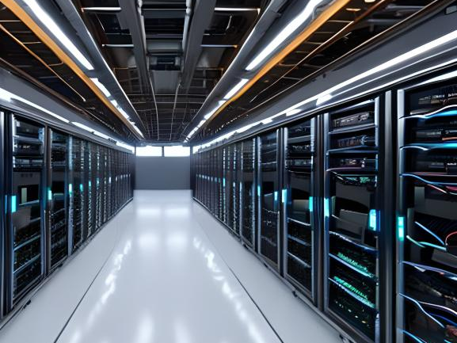
Scalability
Notes:
WHAT does scalability even mean in terms of open source project: ability of a project to increase its performance or capacity when more resources are added to the system. In the context of open source projects, scalability ensures that the project can accommodate more users or resources without having to make significant changes to its codebase.
United Nations has the potential of tapping into the power & resources of the global community to scale & accelerate project development. (Rahul can attest to the UN’s effort to achieve Scalability, an alliance led by the Governments of Norway & Sierra Leone, UNICEF & NGO iSPIRT, is working together with other stakeholders to scale open source software in the United Nations.)
The key is how does the project as well as the contributing community benefit for this collaboration.
Next Slide
The platform created for sharing DPG will help to ensure that open source software is accessible & available to all stakeholders)
“The real power of open source leading to scalability is the collaboration of multiple companies contributing resources to an open source project that serves their own goals, as well as those of others.” - Alan Shimel2
“Open source is a great way to get your code out there, but it’s also a great way to get other people’s bugs out there.” - Anonymous1
“Scalability is about more than just handling more users. It’s about building a system that can adapt to changing needs and demands.” - Martin Kleppmann1
“The key to scaling up excellence is to cherish and nurture the mindset that planted it.” - Robert I. Sutton1
“Scaling is not just a matter of adding more resources or doing things bigger; it’s also a matter of doing things faster, smarter, and more efficiently.” - Jeff Sutherland1
Open Source Virtual Developers

Slide 9

Accessibility & Affordability
Notes:
Did you know that an estimated 1.3 billion people worldwide experience significant disabilities that’s 1 in 6 people worldwide?
Accessibility means that its accessible to usable and accessible to as many people as possible, including those with disabilities and those who speak different languages. Other features that can contribute to software accessibility include alternative text for images, captions for videos, keyboard shortcuts for those who cannot use a mouse, and screen readers for users with visual impairments. By empowering developers with disabilities and non-native speakers to build technology that improves access for all, we can create a more inclusive future by treating accessibility not as an option but a requirement.
One of the examples pointed out by Rahul is very relevant here, India has 22 official languages and (according to the 2001 census) an additional 122 “major” languages.
And it turns out that this language diversity has been a major driver for developing skills through OSS, a crucial intangible benefit that one would not have expected OSS offers.
Let me explain: Many teachers in India acquired OSS skills because they translated software that was not available in their teaching language so as to make it accessible for their classes. Many taught themselves basic to advanced coding skills in this task. Teachers with coding skills acted as multipliers to their students, spreading the knowledge of coding and OSS skills to them.
Imagine a world where everyone has equal access to technology & the ability to modify it to meet their needs.
Because open source software is freely available, it can help eliminate the barrier for entry & reduce the digital divide by providing free access to technology to people who may not have been able to afford it otherwise. Meaningful participation in today’s digital age requires a high-speed broadband connection to the Internet. To address these concerns, baselines & targets of “affordability” are necessary, along with universal targets & metrics, such as defining affordable Internet.
I am going to make a bold prediction for the future is the increased use of Offline Models, will touch on this more in a bit. Next Slide
SDG4 Quality Education: Open source software can be used to create educational tools and resources that are freely available to students and teachers, regardless of socioeconomic status.
SDG8 Decent Work and Economic Growth: Open source software can create job opportunities and drive economic growth by enabling businesses and entrepreneurs to access and use technology.
SDG9 Industry, Innovation and Infrastructure: Open source software can be used to spur innovation and advance the development of new technologies and infrastructure, benefiting businesses, communities and society as a whole.
SDG11 Sustainable Cities and Communities: Open source software can be used to develop sustainable urban planning and management systems, improving the lives of people in cities and communities.
SDG12 Responsible Consumption and Production: Open source software can help reduce waste and promote sustainable consumption by providing efficient and effective technology solutions.
SDG16 Peace, Justice and Strong Institutions: Open source software can support the development of transparent and accountable institutions, helping to promote peace and stability, and the rule of law.
while Open source software is often developed by a community of volunteers making it accessible to anyone who wants to contribute or learn from it. It can be modified & customized to meet the needs of users with disabilities, such as those with visual impairments who may need screen readers or high contrast interfaces.
The power of the Web is in its universality. Access by everyone regardless of disability is an essential aspect.” - Tim Berners-Lee1
“Accessibility is not a feature, it is a social trend.” - Antonio Santos1
“The role of genius is not to complicate the simple, but to simplify the complicated.” - Criss Jami2
“I’m not of the opinion that all software will be open source software. But I do think that we can make software more affordable and more accessible by using open source methods.” - Matt Mullenweg4
“Life would be much easier if I had the source code.” - Anonymous
The power of Open Source is the power of the people. The people rule.” - Philippe Kahn1
“In open source, we feel strongly that to really do something well, you have to get a lot of people involved.” - Linus Torvalds
“Open source is a development methodology; free software is a social movement.” - Richard Stallman

Slide 10

Security
Notes:
Most of you know, that popular OSS prjs tend to have larger & more diverse communities of developers?
This means that vulnerabilities can not only be quickly identified but they can be fixed as well. This is partly thanks to crowd-sourced efforts, bug bounty programs, & other innovative techniques such as dependency scanning that shows vulnerabilities within your supply chain, secret scanning to scan any secrets checked in by accident or code scanning to analyze the code for any vulnerabilities. All these tools are freely available to public OSS projects making them in most cases more secure than even proprietary software. Which can be vulnerable to leaks because they are often behind closed walls and enjoy a false sense of security.
Next Slide
(By advocating for transparent & accountable content governance frameworks, we can protect freedom of expression & avoid overly restrictive moderation practices while also addressing concerns around encryption & illegal online content.)
“Given the importance of digital infrastructure in our lives, it’s time to start thinking of it in the same way we do our physical infrastructure. Open source software is a connective tissue for much of the online world — it deserves the same focus and funding we give to our roads and bridges.” Google2
Security in open source is also like an onion: it has many layers, it can make you cry and it can keep the bad guys away.😂

Slide 11

Top Challenges
Knowledge & Skills gap
Security
Support
Notes:
However it’s not all unicorns & rainbows in Open Source, & I would be remiss if I didn’t highlight some of the top Challenges that might make you hesitate. Depending on how you look at this it, some would argue that Open Source software may not be as secure since it’s open to the public eye. Others may say that not all OSS projects are well supported & may not have the no of contributors either because of the lack of skills or knowledge. Imagine a project that doesn’t have the right checks & balances in place to catch problems. Just like how an empty unsecured house is a target, this may attract less experienced or malicious developers who may introduce security vulnerabilities into the code. Also, an incorrectly configured repository can be vulnerable to exploits. There could even be instances where there is not enough support from volunteers to make the necessary changes, even if a vulnerability is known & a fix exists. I know many of you may have experienced having sent that Pull Request to your favorite open source project only to have it sit there for days with no response from the maintainers.
However these are all solvable issues & we will look at how automation, virtual developers can help resolving some of the easy ones in our upcoming session by Belinda Vennam & test drive some of the techniques with our hands-on workshop Led by Joshua Ku. Next Slide
Why is there a GAP?
•Support, legal and license issues, security and compliance, lack of governance and management, and knowledge and skills gap are challenges with open source software.
•These challenges must be addressed in order to fully realize the potential benefits of open source software.
•Effective governance and management, as well as addressing legal and license issues, are key to overcoming these challenges.
The main challenges of open source is that access to digital solutions is often limited through
copyright regimes and
proprietary systems;
Most existing DPG are not easily accessible because they are often
unevenly distributed in terms of the language, content and infrastructure required to access them.
lack of a "go to" platform.
lack of support and
additional investment to scale up and
successfully implement open source solutions, and
decreased percentage of the Internet that is open-source and public.
Additionally, there is a need for robust human rights and governance frameworks to enhance trust in technology and respond to cyberthreats.
Security concerns related to digital identity include
lack of user agency and choice,
lack of informed consent,
lack of recognition of multiple forms of identity,
lack of space for anonymity, and
lack of transparency when an individual's data is used by government and other entities.
Today we are going to address the HOW with technology.
Open source software can help the United Nations by providing access to digital solutions, accelerating case detection, providing educational resources during school closures, improving humanitarian action across the humanitarian programme cycle, and supporting United Nations peacekeeping efforts.
What’s out of scope of this session is the roadmap.
Start by creation of a strategic and empowered multistakeholder high-level body, having a more focused agenda for the Forum based on a limited number of strategic policy issues, establishing a high-level segment and ministerial or parliamentarian tracks, forging stronger links among the global Forum and its regional, national, sub-regional and youth initiatives, better integrating programme and intersessional policy development work to support other priority areas, addressing the long-term sustainability of the Forum and the resources necessary for increased participation, through an innovative and viable fundraising strategy, enhancing the visibility of the Forum, including through a stronger corporate identity and improved reporting to other United Nations entities.
The Panel recommends that a broad, multi-stakeholder alliance, involving the United Nations, create a platform for sharing digital public goods, engaging talent and pooling data sets, in a manner that respects privacy, in areas related to attaining the SDG. DPG are defined as open-source software, open data, open artificial intelligence models, open standards and open content that adhere to privacy and other applicable international and domestic laws, standards and best practices and do no harm. The Alliance is led by the Governments of Norway and Sierra Leone, the United Nations Children’s Fund and the non-governmental organization iSPIRT, working with other stakeholders.
There are a number of studies and sources that discuss heuristics that can lead to incorrect conclusions, particularly with respect to open source software.
For example, a study published in the International Journal of Information Security in 2019 found that experts typically overestimated the risks associated with open source projects due to their reliance on the availability heuristic. https://link.springer.com/article/10.1007/s10207-018-0423-3
Additionally, a 2017 report published by the Open Source Initiative highlights some of the common misconceptions and cognitive biases related to open source software.
The Open Source Initiative report provides a number of examples of common misconceptions and cognitive biases related to open source software. One example is the assumption that open source software is 'free,' when in fact there may be associated costs in terms of licensing, maintenance, and support. Other examples include the tendency to focus too much on minor details, such as the choice of license, when selecting open source software, and the tendency to overestimate the risks associated with open source projects.
https://opensource.org/files/OSI-2017-Report.pdf

Slide 12

Legal
License
Compliance
Notes:
One of the decisions that you need to make early on sometimes can be viewed as friction point.
When choosing a license, it's important to consider the goals and values of the project and its community, compatibility with other licenses, and the level of collaboration and contribution the project aims to foster. It can be difficult to distinguish between open source and commercial use licenses, as many open source licenses are also compatible with commercial use and there are nuances that may be open to interpretation & not be well understood even if you have a law degree.
Strong Copyleft licenses promote collaboration and sharing among developers, but can be overly restrictive and discourage some developers from contributing. (Strong copyleft licenses, such as the GNU General Public License (GPL), require that any derivative works of the licensed software also remain open source and free for use by others. While this promotes collaboration and sharing among developers and the open-source community, it can be overly restrictive in certain situations. For example, it may make it more difficult for businesses to use open-source software for their own purposes, as they may be required to release their own code as open source, which could be detrimental to their business interests)
Patent Protection provides legal protection to original creators of open source software, but may discourage some businesses from using it.
Choice overload can make it challenging to decide which license is the best fit for your project. It's important to consider common misconceptions and cognitive biases related to open source software when making a decision, such as the assumption that open source software is 'free.' Ultimately, the choice of license will depend on the specific needs and goals of the project and its community. Next Slide
The main challenges of open source is that access to digital solutions is often limited through
copyright regimes and
proprietary systems;
Most existing DPG are not easily accessible because they are often
unevenly distributed in terms of the language, content and infrastructure required to access them.
lack of a "go to" platform.
lack of support and
additional investment to scale up and
successfully implement open source solutions, and
decreased percentage of the Internet that is open-source and public.
Additionally, there is a need for robust human rights and governance frameworks to enhance trust in technology and respond to cyberthreats.
Security concerns related to digital identity include
lack of user agency and choice,
lack of informed consent,
lack of recognition of multiple forms of identity,
lack of space for anonymity, and
lack of transparency when an individual's data is used by government and other entities.
Today we are going to address the HOW with technology.
Open source software can help the United Nations by providing access to digital solutions, accelerating case detection, providing educational resources during school closures, improving humanitarian action across the humanitarian programme cycle, and supporting United Nations peacekeeping efforts.
What’s out of scope of this session is the roadmap.
Start by creation of a strategic and empowered multistakeholder high-level body, having a more focused agenda for the Forum based on a limited number of strategic policy issues, establishing a high-level segment and ministerial or parliamentarian tracks, forging stronger links among the global Forum and its regional, national, sub-regional and youth initiatives, better integrating programme and intersessional policy development work to support other priority areas, addressing the long-term sustainability of the Forum and the resources necessary for increased participation, through an innovative and viable fundraising strategy, enhancing the visibility of the Forum, including through a stronger corporate identity and improved reporting to other United Nations entities.
The Panel recommends that a broad, multi-stakeholder alliance, involving the United Nations, create a platform for sharing digital public goods, engaging talent and pooling data sets, in a manner that respects privacy, in areas related to attaining the SDG. DPG are defined as open-source software, open data, open artificial intelligence models, open standards and open content that adhere to privacy and other applicable international and domestic laws, standards and best practices and do no harm. The Alliance is led by the Governments of Norway and Sierra Leone, the United Nations Children’s Fund and the non-governmental organization iSPIRT, working with other stakeholders.
There are a number of studies and sources that discuss heuristics that can lead to incorrect conclusions, particularly with respect to open source software.
For example, a study published in the International Journal of Information Security in 2019 found that experts typically overestimated the risks associated with open source projects due to their reliance on the availability heuristic. https://link.springer.com/article/10.1007/s10207-018-0423-3
Additionally, a 2017 report published by the Open Source Initiative highlights some of the common misconceptions and cognitive biases related to open source software.
The Open Source Initiative report provides a number of examples of common misconceptions and cognitive biases related to open source software. One example is the assumption that open source software is 'free,' when in fact there may be associated costs in terms of licensing, maintenance, and support. Other examples include the tendency to focus too much on minor details, such as the choice of license, when selecting open source software, and the tendency to overestimate the risks associated with open source projects.
https://opensource.org/files/OSI-2017-Report.pdf
There are several considerations when choosing a license for a software project, including:
The goals and values of the project and its community
Compatibility with other licenses that may be used in the project or that the project may depend on
The level of protection for the project's intellectual property and the ability to control how it is used
The level of collaboration and contribution the project aims to foster
The target audience for the software, including end users and developers
In terms of licenses that promote open source versus those that favor commercial use, it can be difficult to make a clear distinction. Many of the most popular open source licenses, such as Apache 2.0, BSD 3-Clause, and MIT, are also compatible with commercial use. However, licenses such as GPL-2.0, GPL-3.0, and AGPL-3.0 are often considered more restrictive and may be less favorable for commercial use. Ultimately, the choice of license will depend on the specific needs and goals of the project and its community.
Strong Copyleft:
Ensures that any derivative works of the licensed software also remain open source and free for use by others.
Promotes collaboration and sharing among developers and the open-source community.
Helps prevent commercial entities from taking advantage of the open-source community by profiting from software without contributing back to it.
Cons:
Can be overly restrictive, potentially limiting the use of open-source software in certain situations.
Can make it more difficult for businesses to use open-source software for their own purposes, as they may be required to release their own code as open source.
May discourage some developers from contributing to open-source projects if they feel that their work will be subject to strict licensing requirements.
Patent Protection:
Provides legal protection to the original creators of open-source software against infringement by others.
Encourages innovation by incentivizing developers to create and share their work without fear of it being copied without permission.
Can help ensure that open-source software remains free for all to use, rather than being controlled by a single entity.
Cons:
Can be difficult to enforce, particularly in countries with weak intellectual property laws.
May discourage some businesses from using open-source software if they are concerned about potential patent infringement claims.
Can be seen as contradictory to the ethos of open source, which is built on the idea of sharing and collaboration rather than protecting intellectual property.
Compliance is a crucial aspect of open source software development, as it ensures that the software is used and distributed in a way that respects the terms of its open source license. Here are some key considerations for compliance in open source:
License identification: The first step in compliance is to identify the open source licenses that apply to the software being used or distributed. This can be a complex process, as there are many different open source licenses with different requirements and restrictions.
Compliance with license terms: Once the open source licenses have been identified, it is important to ensure that the software is being used and distributed in compliance with the terms of those licenses. This may include requirements such as providing attribution to the original author, making source code available, or sharing modifications under the same license.
Management of dependencies: Open source software often includes dependencies on other open source libraries or components. It is important to ensure that these dependencies are also compliant with open source licenses and that any requirements are met.
Documentation: Good documentation is essential for compliance, as it helps to ensure that all stakeholders understand the terms of the open source licenses and how they apply to the software being used or distributed.
Ongoing compliance: Compliance is not a one-time activity, but an ongoing process. It is important to have processes in place to monitor compliance over time, especially as software evolves and new versions or dependencies are added.
In summary, compliance with open source licenses is an essential aspect of open source software development, and organizations must take proactive steps to ensure that they are meeting all license requirements.

Slide 13

Lack of governance, management.
Notes:
The right Governance model can be crucial in driving the long term roadmap of the project. Depending on the type of project this can often be a critical factor with any new technologies. There are also some advantages with some models where it’s a jointly backed by for profit company vs run by foundation. However the incentives are not always aligned.
| Governance Model | Example | Roles | Trust & Quality | Objectives & Expectations |
|:-------------------------:|:------------:|:--------:|:--------------------:|:-----------------------------------:|
| Self-Governance meritocracy | Open Source Projects | Decisions on project direction, strategy and goals are made by the community | Quality is ensured through peer review and open feedback from the users | Responsibilities must be shared among members, and trust must be established to ensure successful collaboration.
| Traditional Corporate | Microsoft Azure | Leadership from company | Quality can be difficult to maintain | Company has full control |
| Joint Venture - hybrid | Linux | Both corporations and communities collaborate | Quality is easier to maintain | Willingness to share responsibilities is key |
| Foundation-Driven | Apache Foundation | Foundation leads the project | Quality is monitored and maintained | Foundation must be trusted to ensure fairness and inclusion |
| DAO (Decentralized Autonomous Organization) consensus-driven | MakerDAO | Decision-making is done by the community without a central leader or third-party intermediary | Quality is assured by automated smart contracts and decentralized governance | Autonomy and transparency must be maintained in order to ensure fairness |
While lack of governance and management can be a challenge for open source projects, the benefits far outweigh any risks. Research shows that we tend to overestimate the risks associated with open source due to cognitive biases such as loss aversion. Choosing the right open source license is key, but don't let that stop you from fully realizing the potential of open source software. You need to follow the rules of the licenses, watch out for security holes, and lean on OSPO to advise us on these issues. I promise there is light at the end of the tunnel and where there is light there can be unicorns & rainbows. Next Slide
There are a number of studies and sources that discuss heuristics that can lead to incorrect conclusions, particularly with respect to open source software.
For example, a study published in the International Journal of Information Security in 2019 found that experts typically overestimated the risks associated with open source projects due to their reliance on the availability heuristic. https://link.springer.com/article/10.1007/s10207-018-0423-3
Additionally, a 2017 report published by the Open Source Initiative highlights some of the common misconceptions and cognitive biases related to open source software.
The Open Source Initiative report provides a number of examples of common misconceptions and cognitive biases related to open source software. One example is the assumption that open source software is 'free,' when in fact there may be associated costs in terms of licensing, maintenance, and support. Other examples include the tendency to focus too much on minor details, such as the choice of license, when selecting open source software, and the tendency to overestimate the risks associated with open source projects.
https://opensource.org/files/OSI-2017-Report.pdf
https://opensource.guide/best-practices
https://opensource.guide/leadership-and-governance/
BDFL: BDFL stands for “Benevolent Dictator for Life”. Under this structure, one person (usually the initial author of the project) has final say on all major project decisions. Python is a classic example. Smaller projects are probably BDFL by default, because there are only one or two maintainers. A project that originated at a company might also fall into the BDFL category.
Meritocracy: (Note: the term “meritocracy” carries negative connotations for some communities and has a complex social and political history.) Under a meritocracy, active project contributors (those who demonstrate “merit”) are given a formal decision making role. Decisions are usually made based on pure voting consensus. The meritocracy concept was pioneered by the Apache Foundation; all Apache projects are meritocracies. Contributions can only be made by individuals representing themselves, not by a company.
Liberal contribution: Under a liberal contribution model, the people who do the most work are recognized as most influential, but this is based on current work and not historic contributions. Major project decisions are made based on a consensus seeking process (discuss major grievances) rather than pure vote, and strive to include as many community perspectives as possible. Popular examples of projects that use a liberal contribution model include Node.js and Rust.
The main challenges of open source is that access to digital solutions is often limited through
copyright regimes and
proprietary systems;
Most existing DPG are not easily accessible because they are often
unevenly distributed in terms of the language, content and infrastructure required to access them.
lack of a "go to" platform.
lack of support and
additional investment to scale up and
successfully implement open source solutions, and
decreased percentage of the Internet that is open-source and public.
Additionally, there is a need for robust human rights and governance frameworks to enhance trust in technology and respond to cyberthreats.
Security concerns related to digital identity include
lack of user agency and choice,
lack of informed consent,
lack of recognition of multiple forms of identity,
lack of space for anonymity, and
lack of transparency when an individual's data is used by government and other entities.
Today we are going to address the HOW with technology.
What’s out of scope of this session is the roadmap.
Start by creation of a strategic and empowered multistakeholder high-level body, having a more focused agenda for the Forum based on a limited number of strategic policy issues, establishing a high-level segment and ministerial or parliamentarian tracks, forging stronger links among the global Forum and its regional, national, sub-regional and youth initiatives, better integrating programme and intersessional policy development work to support other priority areas, addressing the long-term sustainability of the Forum and the resources necessary for increased participation, through an innovative and viable fundraising strategy, enhancing the visibility of the Forum, including through a stronger corporate identity and improved reporting to other United Nations entities.
The Panel recommends that a broad, multi-stakeholder alliance, involving the United Nations, create a platform for sharing digital public goods, engaging talent and pooling data sets, in a manner that respects privacy, in areas related to attaining the SDG. DPG are defined as open-source software, open data, open artificial intelligence models, open standards and open content that adhere to privacy and other applicable international and domestic laws, standards and best practices and do no harm. The Alliance is led by the Governments of Norway and Sierra Leone, the United Nations Children’s Fund and the non-governmental organization iSPIRT, working with other stakeholders.
One of the biggest challenges in open source software development is the lack of management, which can lead to problems such as:
Lack of coordination: In an open source project, there may be many contributors working on different parts of the software. Without effective management, it can be difficult to ensure that everyone is working towards the same goals and that work is being prioritized effectively.
Unclear decision-making: In an open source project, decisions about the direction of the software may be made by consensus or by a core group of contributors. Without clear management, it can be difficult to ensure that decisions are being made in a timely and effective manner.
Difficulty in managing contributors: With many contributors working on an open source project, it can be challenging to manage their work and ensure that they are making progress towards project goals. This can lead to issues such as missed deadlines, duplicated effort, or work that is not aligned with the project's overall objectives.
Lack of accountability: Without effective management, it can be difficult to hold contributors accountable for their work and to ensure that they are meeting their commitments to the project.
Lack of sustainability: Open source projects can be challenging to sustain over the long term, particularly if there is a lack of management or support. This can lead to issues such as project stagnation, lack of innovation, or loss of contributors.
To address these challenges, effective management practices are essential in open source software development. This may include processes for coordinating work, decision-making, and managing contributors, as well as ensuring accountability and sustainability over the long term.

Slide 14
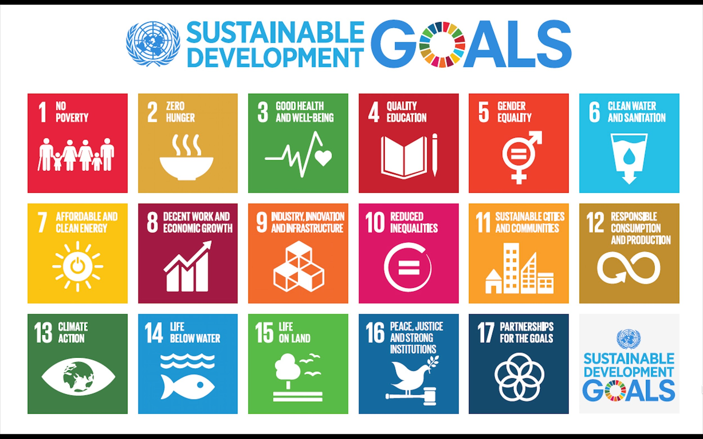
Notes:
The United Nations has a vision of a world where human rights, social justice, and environmental protection are upheld. And open source technologies can help make this a reality by enabling access, enhancing collaboration, safeguarding privacy, and promoting sustainability. By collaborating openly, we can accelerate innovation, increase transparency, and empower communities to achieve the Sustainable Development Goals together.
• There are 142 Digital Public Goods projects, including 15 in content, 14 in data, 121 in software, and none in AI models or standards. most of our time went to initiatives focused on SDGs 9 (The MERL Center ) and SDG17
• The top three SDGs with the most Digital Public Goods projects are #3 Good Health and Well-being (72 projects), #4 Quality Education (34 projects), and #10 Reduced Inequality (31 projects).
• There are single-digit contributions to SDG 14 (Life Below Water - 2 projects), SDG 7 (Affordable and Clean Energy - 7 projects), and SDG 12 (Responsible Consumption & Production - 9 projects).
• There is ongoing work in the area of Geo AI, which may soon be available as a Digital Public Good.
With open source software, the UN can achieve world peace, one line of code at a time.
Bonus point if you can spot which one from the first slide is already a DPG
for those high-achievers & home work for others: What SDG does it align to?
When I was reflecting on this vision of United Nations, I stumbled upon the Key to executing this vision and I was surprised it was hidden in plain sight.
Maybe you know this already and its genius.
The Key TO EXECUTE THIS VISION in the Vision itself With SDG 17 Partnerships for the Goals where most of the focus of Open Source lies. None of this is possible without SDG17.
Now I understand why our focus has been on 17 & Kudos to Cynthia who has been primarily driving our skill based volunteer contribution towards SDG 17, part of that effort was to support to the newly created WHO open source programme offices (OSPO) and the anticipated ITU OSPO.
SDG9 (Industry, Innovation and Infrastructure) https://github.com/MERLTech https://merlcenter.org
The monitoring, evaluation, research and learning (MERL) Center is a community creating resources about the intersection of MERL and open source, data science and human-centered design, for people of any technology capacity. Exploring the use of technology for monitoring, evaluation, research, and learning.
SDG10 (Reduced Inequalities)
We also spent time on work related to SDG 10, target 7, “Facilitate orderly, safe, regular and responsible migration and mobility of people, including through the implementation of planned and well-managed migration policies.” In 2022, GitHub partnered with the organization, Mobile Pathways, which creates apps and SMS services to help immigrants navigate the US immigration system by connecting them with attorneys. We developed a series of data visualizations and an ArcGis map to analyze how and where migrants need employment and immigration support throughout the United States. The goal is to ensure migrants have a pathway to live and work.
About my prediction for the future is the increased use of Offline Models:
SDG 4 Quality Education: Open source software can be used to create educational tools and resources that are freely available to students and teachers, regardless of socioeconomic status.
SDG 8 Decent Work and Economic Growth: Open source software can create job opportunities and drive economic growth by enabling businesses and entrepreneurs to access and use technology.
SDG 9 Industry, Innovation and Infrastructure: Open source software can be used to spur innovation and advance the development of new technologies and infrastructure, benefiting businesses, communities and society as a whole.
SDG 11 Sustainable Cities and Communities: Open source software can be used to develop sustainable urban planning and management systems, improving the lives of people in cities and communities.
SDG 12 Responsible Consumption and Production: Open source software can help reduce waste and promote sustainable consumption by providing efficient and effective technology solutions.
SDG 16 Peace, Justice and Strong Institutions: Open source software can support the development of transparent and accountable institutions, helping to promote peace and stability, and the rule of law.
Open source software can help the United Nations by providing access to digital solutions, accelerating case detection, providing educational resources during school closures, improving humanitarian action across the humanitarian programme cycle, and supporting United Nations peacekeeping efforts.
https://digitalpublicgoods.net/registry
PRISM is a climate risk monitoring system developed by the World Food Programme (WFP) that integrates geospatial data on hazards such as droughts, floods, tropical storms, and earthquakes, with information on socioeconomic vulnerability. The goal is to inform disaster risk reduction and social assistance programs. The platform provides tools to governments, national disaster management organizations, and key line ministries to monitor risks, prioritize responses and inform programs and policies. PRISM produces interactive maps, charts, tables and reports that display climate risk monitoring indicators and risk and impact analytical products. The information can be used to mitigate the impact of climate-driven hazards by providing decision-makers with the most up-to-date risk and impact analytics. PRISM is actively used by government partners in Indonesia, Sri Lanka, Mongolia, and Cambodia and is forthcoming in several deployments across Asia and Africa. The project is recognized as a digital public good by the Digital Public Goods Alliance.
SDG1: End Poverty in all its forms everywhere, enabling them to participate in the global economy and improve their standard of living.
SDG2: Zero Hunger, can be used to improve supply chain management and increase efficiency in agriculture and food production, leading to greater food security.
SDG11: Sustainable Cities and Communities, develop sustainable urban planning and management systems, improving the lives of people in cities and communities.
SDG13: Climate Action, help mitigate and adapt to the impacts of climate change by promoting the use of renewable energy, reducing emissions, and increasing energy efficiency.
https://app.digitalpublicgoods.net/a/10088
No Poverty: Open source software can provide access to technology and digital tools to those in developing countries, enabling them to participate in the global economy and improve their standard of living.
Zero Hunger: Open source software can be used to improve supply chain management and increase efficiency in agriculture and food production, leading to greater food security.
Good Health and Well-Being: Open source software can be used to develop and distribute low-cost medical technologies, improve data collection and analysis for public health initiatives, and provide access to health information for communities around the world.
Quality Education: Open source software can be used to create educational tools and resources that are freely available to students and teachers, regardless of socioeconomic status.
Gender Equality: Open source software can provide equal access to technology and resources for women and girls, helping to close the gender digital divide.
Clean Water and Sanitation: Open source software can be used to improve water resource management and develop low-cost water and sanitation systems for communities in need.
Affordable and Clean Energy: Open source software can be used to develop and implement renewable energy systems, and increase energy efficiency, reducing greenhouse gas emissions and dependence on fossil fuels.
Decent Work and Economic Growth: Open source software can create job opportunities and drive economic growth by enabling businesses and entrepreneurs to access and use technology.
Industry, Innovation and Infrastructure: Open source software can be used to spur innovation and advance the development of new technologies and infrastructure, benefiting businesses, communities and society as a whole.
Reduced Inequalities: Open source software can help reduce economic and social inequalities by providing equal access to technology and information resources.
Sustainable Cities and Communities: Open source software can be used to develop sustainable urban planning and management systems, improving the lives of people in cities and communities.
Responsible Consumption and Production: Open source software can help reduce waste and promote sustainable consumption by providing efficient and effective technology solutions.
Climate Action: Open source software can help mitigate and adapt to the impacts of climate change by promoting the use of renewable energy, reducing emissions, and increasing energy efficiency.
Life Below Water: Open source software can be used to monitor and protect oceans, marine life and coastal communities.
Life on Land: Open source software can be used to support conservation and sustainable management of terrestrial ecosystems, forests, and biodiversity.
Peace, Justice and Strong Institutions: Open source software can support the development of transparent and accountable institutions, helping to promote peace and stability, and the rule of law.
Partnerships for the Goals: Open source software can facilitate collaboration and partnership between governments, businesses, and civil society, increasing the impact of efforts to achieve the Sustainable Development Goals.
Key Considerations for Successful DPGs:
• The need to involve the public in their design
• The importance of having a clear purpose and scope
• The role of cross-sectoral collaboration
• The need to leverage technology and data
• The necessity of appropriate regulation
• The need for effective sustainable financing
Steps to Ensure Long-term Success:
• Set up clear guidelines and systems
• Establish performance metrics and tracking mechanisms
• Establish impact evaluation systems
• Encourage public participation & Incorporate public input
• Invest in research and development
To identify and scale up effective projects:
• Assess the need for the project
• Identify potential partners and stakeholders
• Perform a cost-benefit analysis
• Evaluate technological feasibility
• Analyze the economic and political implications & social impacts
• Collect data and stakeholder feedback
• Develop a long-term plan for scaling up the project
• Ensure the project is in line with government policies
• Monitor progress and adjust as needed.
• Define regulations or policies needed
• Standards are an important tool for creating digital public goods (DPGs).
• Standards provide guidance, create interoperability, and promote competition.
• Several standards exist in India across sectors such as finance, healthcare, and public services.
• International standards can be adopted or adapted by nations to create its own national standards.
• Standards should be developed through an open and participatory process.
• Effective implementation of standards requires collaboration across stakeholders.
• It is important to consider the cost of implementing standards, as well as their potential benefits.
• Standards should be regularly reviewed and updated to ensure they remain relevant.
• National standards should be globally aligned to promote global trade.
• Standards are an important tool for promoting the use of DPGs .

Slide 15
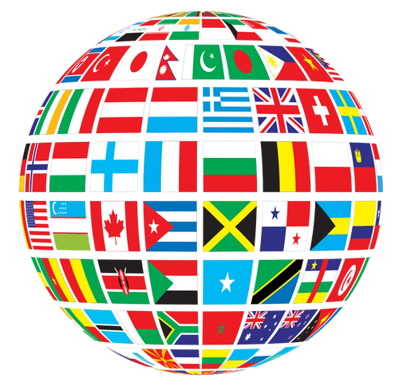
Global Collaboration
Project source code
United nations oss project
March 2023
Notes:
Representation in the training of models so there is reduced bias and each community has representation.
Regional algorithms or models can be developed
#17: Partnerships for the Goals
Open source software provides a platform for collaboration and partnerships among individuals, organizations, and governments. By pooling resources and working together towards a common goal, open source initiatives can help drive progress towards the Sustainable Development Goals. This model of cooperation and collaboration can serve as a model for other initiatives aimed at promoting sustainable development.

Slide 16
Global Collaboration
Project source code
United nations oss project
March 2023
Notes:
To achieve this vision by tapping into the global community of developers is also one of the SDGs.
SDG 17 Partnerships for the Goals
Open source software provides a platform for collaboration and partnerships among individuals, organizations, and governments. By pooling resources and working together towards a common goal, open source initiatives can help drive progress towards the Sustainable Development Goals. This model of cooperation and collaboration can serve as a model for other initiatives aimed at promoting sustainable development.
SDG 17 Partnerships for the Goals: collaboration and partnership between governments, businesses, and civil society, increasing the impact of efforts to achieve the Sustainable Development Goals.
Partnerships are critical to achieving the SDGs.
Successful partnerships require strong leadership, shared vision, clear goals, effective communication, and transparent governance.
SDG partnerships should prioritize the needs of the most vulnerable and marginalized populations, guided by principles of inclusion, equity, and sustainability.
SDG partnerships can benefit from technology, data, and innovative financing models.
SDG partnerships should focus on building capacity, promoting learning and knowledge sharing, and prioritizing cross-cutting issues such as gender equality, human rights, and environmental sustainability.
One desirable side effect of this global collaboration w r t to AI is this increases
Representation in the training of models so there is reduced bias and each community has representation.
This can also lead to Regional algorithms or models can be developed by respective communities while enjoying the benefits of the base model.
GLOBAL COLLABORATION
I want to share some statistics that align with UN’s vision statement and show that it’s a step in the right direction and utilizes the economies of scale.
Are you ready for some statistics? Next Slide

Slide 17
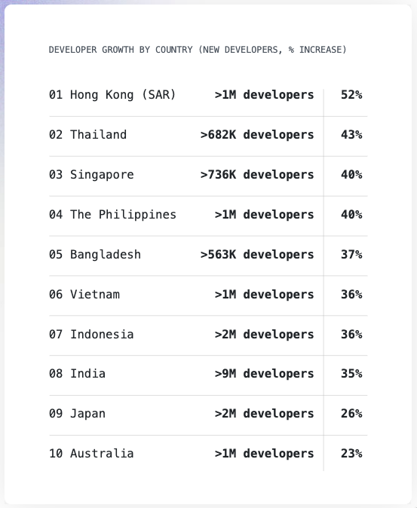
Fastest growing
Asia Pacific countries
developer communities
We cannot think without data...Our clients are poor, and we needed good data sets to understand what was missing or lacking. But data is not cheap….and the requirements keep changing with each project. There has to be a certain amount of flexibility and I found that with the open source community. - Pratima Joshi, Shelter Associates (India)
Notes:
I want to share some statistics that align with UN’s vision statement and show that it’s a step in the right direction and utilizes the economies of scale.
Are you ready for some statistics?
For the past 10 years we @ github have released Octoverse report to celebrate 2.8 to 100 million people using GitHub.
I want to showcase numbers from top 3 regions that had the largest increase in terms of % the past year.
To put this slide in perspective we have over 100M developers out of that 20% new developers joining in 2022, 90% of the companies use open source and there were 413M open source contributions in 2022.
UN projects have the potential to tap into this large pool of resources.
•Pratima Joshi of Shelter Associates in India found open source community to be a valuable resource.
•Data is not cheap, but open source community provides flexibility and good data sets for understanding what is missing or lacking in projects. •Data is essential, but expensive and requirements change with each project.
•Open source community provides flexibility and good data sets for understanding what is missing or lacking in projects.
25 of 142 SDGs are related to data and content SDG
WaPOR
Imagine A farmer is trying to become more efficient in their water use for their crop fields. With the right data, The farmer is able to make better decisions for agricultural water management and improve their crop yields.
With the WaPOR one of the DPG, Framers can access FAO portal to monitor water productivity through open access of remotely sensed derived data. They use the Global Bottom-up Water Productivity approach to analyze their water productivity and gain insights on how to achieve better water use efficiency. Next Slide
The Social Sector and DPG OSS governmental policies and government-adopted DPG
#7 Affordable and Clean Energy: 7 Open source software can be used to develop and implement renewable energy systems, and increase energy efficiency, reducing greenhouse gas emissions and dependence on fossil fuels. #8 Decent Work and Economic Growth: Open source software can create job opportunities and drive economic growth by enabling businesses and entrepreneurs to access and use technology.
#9 Industry, Innovation and Infrastructure: Open source software can be used to spur innovation and advance the development of new technologies and infrastructure, benefiting businesses, communities and society as a whole.

Slide 18
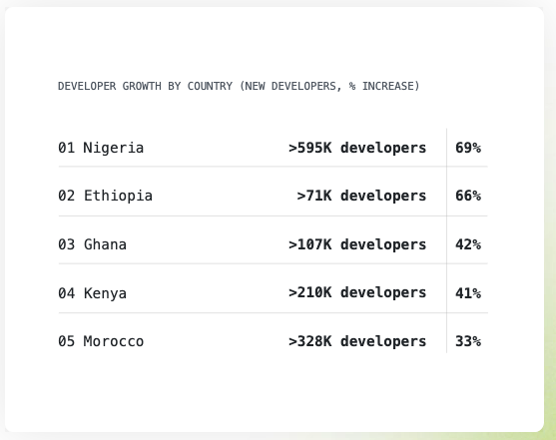
Fastest growing African developer communities
Learning OSS makes you not dependent on a tool, but you are learning a process instead. You can easily adapt to anything, and people who graduate from Tunapanda have a benefit over other people because of the learning process. - Mwalugha Bura, Tunapanda Institute (Kenya)
Notes:
As Nelson Mandela says, "Education is the most powerful weapon which you can use to change the world.” Open source is a powerful tool for education and empowerment. Open source education can empower individuals and communities to build a better future for themselves”
•Mwalugha Bura of Tunapanda Institute in Kenya (started as a Student of Science Tunapanda Institute in Nairobi, Kenya and now is a trainer, he was helping as an untrained teacher since there was minimal number of teachers.) emphasizes the value of open source learning.
•Graduates of Tunapanda Institute in Kenya have a benefit over others in the job market due to open source learning process. •Open source learning process makes people adaptable and gives them a benefit over others in the job market. •Learning open source software makes people not dependent on a tool, but on a process.
I would be bold to even say that every project that united nation participates in the open source community could be considered as aligning to the SDG#4.
Language, Culture, and Education
OSS in high education, non-traditional education routes to OSS, spoken language and regional differences
#4 Open source software can be used to create educational tools and resources that are freely available to students and teachers, regardless of socioeconomic status.

Slide 19
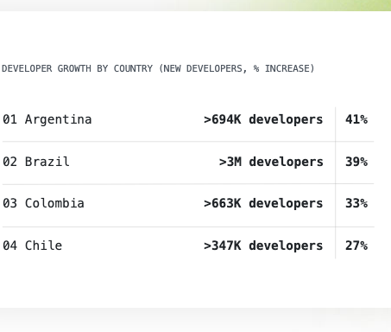
Fastest growing South American developer communities
The Latin American community was especially closely knit during the pandemic. People were coding and building things together. The remote aspect of it got more people involved
- Emilio Velis, Appropredia (El Salvador / Latin America-wide)
Notes:
•Emilio Velis of Appropredia in El Salvador and Latin America-wide emphasizes the value of open source software in bringing people together.
•The Latin American community was closely knit during the pandemic, with people coding and building things together remotely.
•Open source software has a positive impact on community building and collaboration in Latin America.

Slide 20

Transparency
Notes:
If this is not enough, someone of you will not be surprised to know some open source contributions originate from Virtual Developers, some do that via Pull Requests, others could be in the form of reviews, and sometimes even managing the community contributions. Virtual Developer contributions exist and their capabilities will only continue to increase in the coming months.
Yes I said months and not years.
I want to close my bit with the most important aspects of why using open source is not an option but a necessity.
The transparency and accessibility of open source code also enables easier collaboration and sharing of information.
With the exponential advancements in AI technology in the past couple of months, it is more important than ever to understand the inner workings of these models. By embracing open source principles, we can increase transparency, improve accountability, and enhance public trust. open source community has made significant strides in the AI sector, with numerous projects and initiatives aimed at increasing transparency and promoting ethical AI. & I am excited to be part of this community.
Open source allows for transparency and collaboration, which can improve the accuracy and fairness of AI algorithms. It also addresses the problem of data, system, and outcome opacity in decision-making processes, promoting greater transparency and less bias. By opening software, we can transform AI development and create a more inclusive future.
AI systems are usually based on large datasets and large amounts of code. This makes it difficult to own and control them by a single person or entity. Open Source allows organisations and individuals to examine an algorithm, investigate its effects and improve it, which can have a positive impact on both the algorithm’s accuracy as well as its fairness, and the merit of transparency through collaborative development. The problems of data, system and outcome opacity of such systems and decision-making processes have pushed numerous stakeholders to strive and push for greater transparency and less bias in AI developments. Opening software is one of the ways to improve these features, however, in order to be transparent, an AI system often needs to be not only Open Source.
variety of tools available to help automate some aspects of maintenance work. A few examples:
semantic-release automates your releases
mention-bot mentions potential reviewers for pull requests
Danger helps automate code review
no-response closes issues where the author hasn’t responded to a request for more information
dependabot checks your dependency files every day for outdated requirements and opens individual pull requests for any it finds

Slide 21

Empowerment
Notes:
As we come to the end of my session, I want to emphasize the most transformative aspect of open source: Empowerment.
Open Source empowers developers to learn, make a change, contribute back to the community & create equity.
Through global collaboration, we have the potential to create a more inclusive world, one line of code at a time.
So Let us embrace the power of open source and work together to build a brighter future for all.
Now It is my pleasure to introduce you to Gemma, the CEO & Co-Founder of Ersilia (Next Slide) who will share how her non-profit is leveraging open source to transform the world of data science research in low-resourced EDC – Economically developing countries.
It’s truly an inspiring story of empowerment that I am glad to be part of.
By collaborating on a global scale, they provide transparency and accessibility to machine learning models, empowering universities, hospitals, and laboratories to tackle infectious and neglected diseases. Imagine the possibilities of a world where all researchers can afford to have access to cutting-edge technology and knowledge without having to pay for expensive licenses.
It is my pleasure to introduce you to Gemma, the co-founder & CEO of Ersilia to showcase the potential of open source collaboration in field of data science for research on infectious and neglected diseases in low-resourced countries. This collaboration at a global level provides transparency on machine learning models, empowers universities, hospitals, & laboratories to make data science machine learning models accessible for infectious and neglected disease research.
#10: Reduced Inequalities
Open source software can help reduce inequalities by providing access to technology and software for communities and individuals who may not have the resources to purchase proprietary software. This can help bridge the digital divide and provide equal opportunities for education, job training, and economic growth. #5 Gender Equality: Open source software can provide equal access to technology and resources for women and girls, helping to close the gender digital divide.

Slide 22

Ersilia
Notes:
Now It is my pleasure to introduce you to Gemma, the CEO & Co-Founder of Ersilia who will share how her non-profit is leveraging open source to transform the world of data science research in low-resourced EDC – Economically developing countries.
It’s truly an inspiring story of empowerment that I am glad to be part of. Next Slide
Martin Luther King Jr. - "The ultimate measure of a man is not where he stands in moments of comfort and convenience, but where he stands at times of challenge and controversy. Open source is such a challenge, but its potential for creating a more just and equitable world is immense."
Mahatma Gandhi - "Be the change you wish to see in the world. Open source is not just a technology, it's a way of thinking and collaborating that can transform society for the better."
Nelson Mandela - "Education is the most powerful weapon which you can use to change the world. Open source education can empower individuals and communities to build a better future for themselves."
Abraham Lincoln - "With public sentiment, nothing can fail; without it, nothing can succeed. The power of open source lies in its ability to engage and mobilize a global community for the greater good."
Barack Obama - "Change will not come if we wait for some other person or some other time. We are the ones we've been waiting for. The open source movement is proof that ordinary people can do extraordinary things when they work together."
Maya Angelou - "I've learned that people will forget what you said, people will forget what you did, but people will never forget how you made them feel. The open source community is built on a foundation of respect, trust, and collaboration that creates lasting connections and meaningful impact."
Albert Einstein - "The important thing is not to stop questioning. Curiosity has its own reason for existing. Open source is fueled by a relentless curiosity and passion for innovation that pushes the boundaries of what's possible."

Slide 23
Benin Lenin, Cynthia Lo, Mithusa Kajendran, Omar Mohsine & Sebastian Rocca

Slide 24
Introduction - GitHub Team
Belinda Vennam
SKi Sankhe
Joshua Ku
Senior Manager, Software Engineering
Senior Solutions Architect
Service Delivery Engineer

